Slide 1
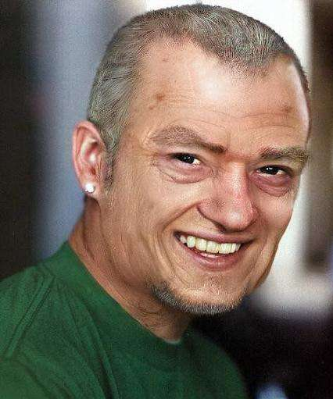
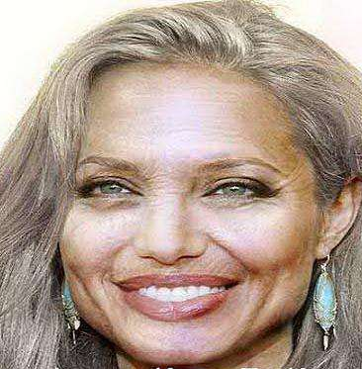
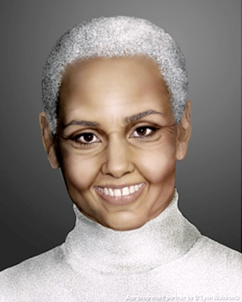
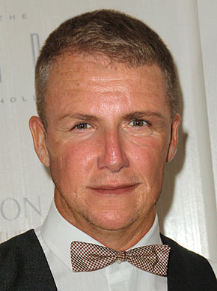
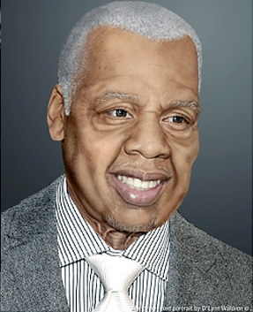
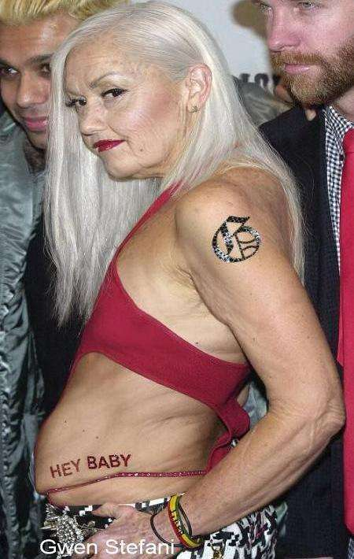
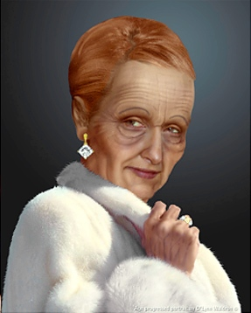
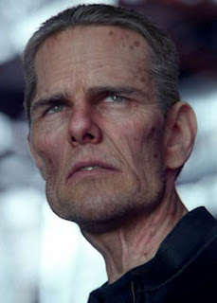
Task 1 - When we get old….

Slide 2
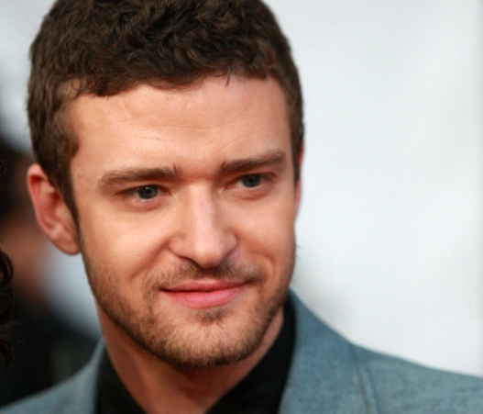
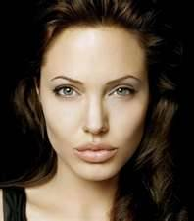
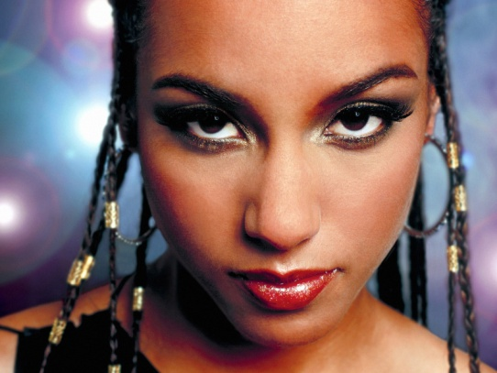
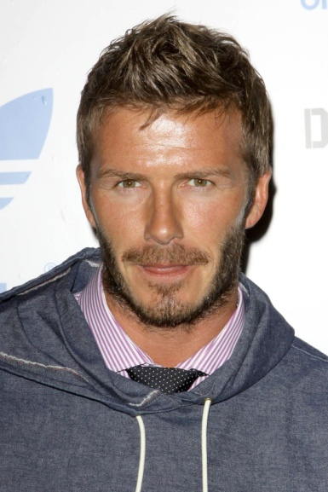
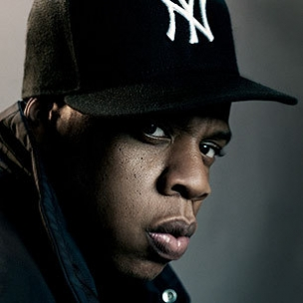
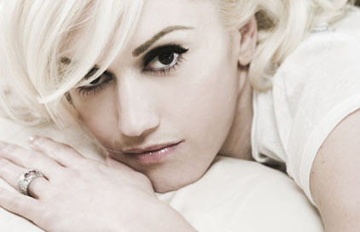
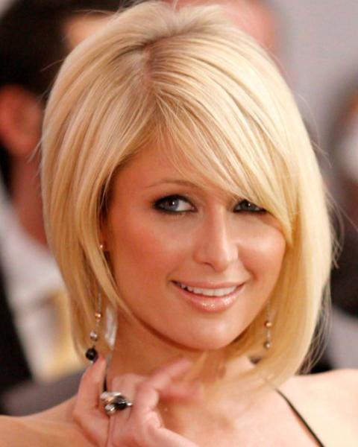
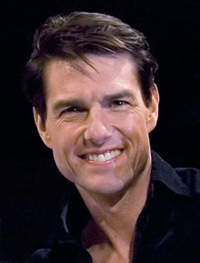
When we get old….
1
2
3
4
Alicia Keys
Justin Timberlake
David Beckham
Angelina Joli
8
5
Gwen Stefani
Jay-Z
6
7
Paris Hilton
Tom Cruise

Slide 3
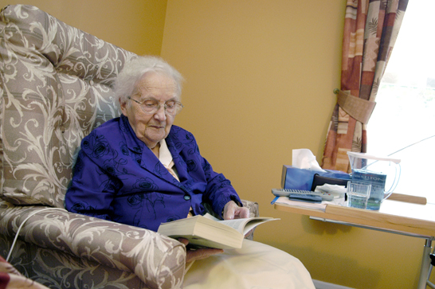
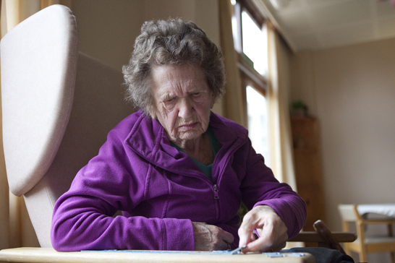
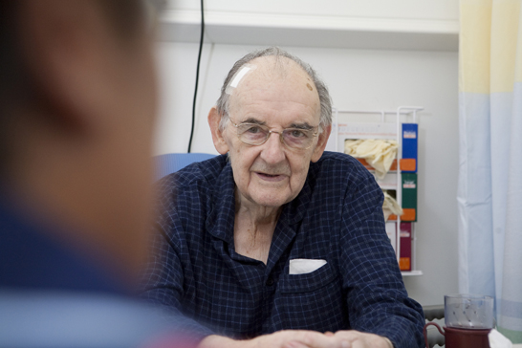
Understanding dementia

Slide 4
Lesson objectives
To raise awareness of dementia
To develop knowledge and understanding about the types dementia and its causes

Slide 5
Task 2 - What you know about dementia? What do you want to find out?
FIND OUT
?
KNOW

Slide 6
Task 3 – What do you understand by the term demetia?

Slide 7
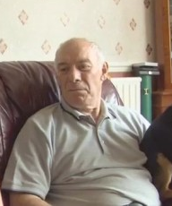
Jim
http://www.nhslocal.nhs.uk/story/features/dementia-schools-teaching-aid-part-2-0

Slide 8
Task 4 - What is dementia?
The term 'dementia' is used to describe the symptoms that occur when the brain is affected by specific diseases and conditions
Dementia is progressive, which means the symptoms will gradually get worse
How fast dementia progresses will depend on the individual
Symptoms include loss of memory, mood changes and communication problems
There are about 800,000 people in the UK with dementia.
Dementia mainly affects people over the age of 65 and the likelihood increases with age. However, it can affect younger people: there are over 17,000 people in the UK under the age of 65 who have dementia.
Dementia can affect men and women.

Slide 9
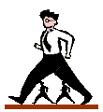
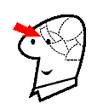
Symptoms
SPEAKING
MEMORY
MOVEMENT
COGNITION
EYESIGHT
HEARING

Slide 10
Task 5 - Different types of dementia?
There are several diseases and conditions that cause dementia.
These include:
Alzheimer's disease − The most common cause of dementia. During the course of the disease the chemistry and structure of the brain changes, leading to the death of brain cells
Vascular disease − The brain relies on a network of vessels to bring it oxygen-bearing blood. If the oxygen supply to the brain fails, brain cells are likely to die and this can cause the symptoms of vascular dementia. These symptoms can occur either suddenly, following a stroke, or over time through a series of small strokes
Dementia with Lewy bodies − This form of dementia gets its name from tiny spherical structures that develop inside nerve cells. Their presence in the brain leads to the degeneration of brain tissue. Memory, concentration and language skills are affected.

Slide 11
Fronto-temporal dementia (including Pick's disease) − In fronto-temporal dementia, damage is usually focused in the front part of the brain. At first, personality and behaviour are more affected than memory. Pick's disease is a relatively rare form of dementia that causes a slow shrinking of brain cells due to excess protein build-up.
Alcohol Related Dementia - Korsakoff's syndrome - Excessive drinking over a period of years may lead to a condition known as Alcohol Dementia, which can cause problems with memory, learning and other cognitive skills.
Parkinson’s disease - The main features of Parkinson’s disease are slowness of movements, difficulty maintaining balance, muscle rigidity, and tremor. The disease is thought to be caused by low levels of a chemical called dopamine , which activates cells in our brains that let us move. About 20% 0f sufferers develop dementia.

Slide 12
Lessening the risk of dementia
At present, it is not clear what causes most of the diseases that lead to dementia. It is not clear what can be done to prevent dementia itself but the evidence does indicate that a healthy diet and lifestyle may help protect against dementia. In particular, exercising regularly, avoiding fatty foods, not smoking, drinking alcohol in moderation and keeping mentally and socially active into old age may help to reduce the risk of developing vascular dementia and Alzheimer's disease.

Slide 13
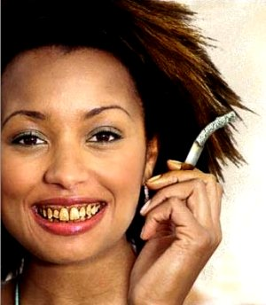
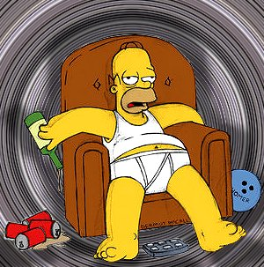
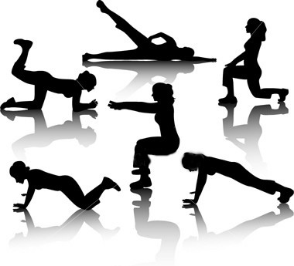
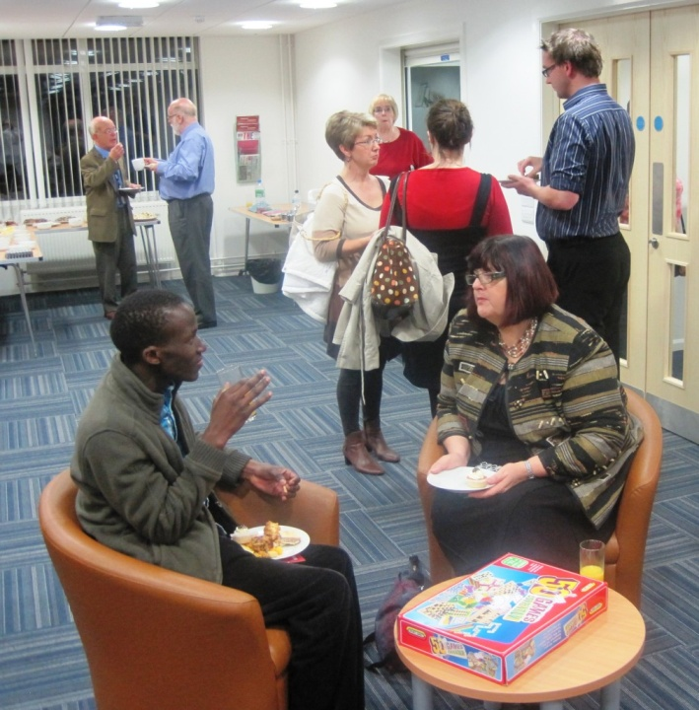
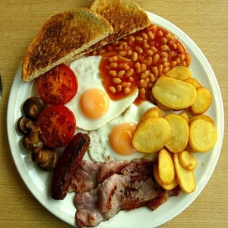
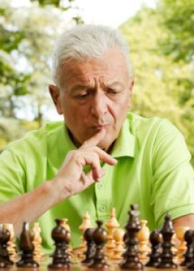
Task 6 - So…

Slide 14
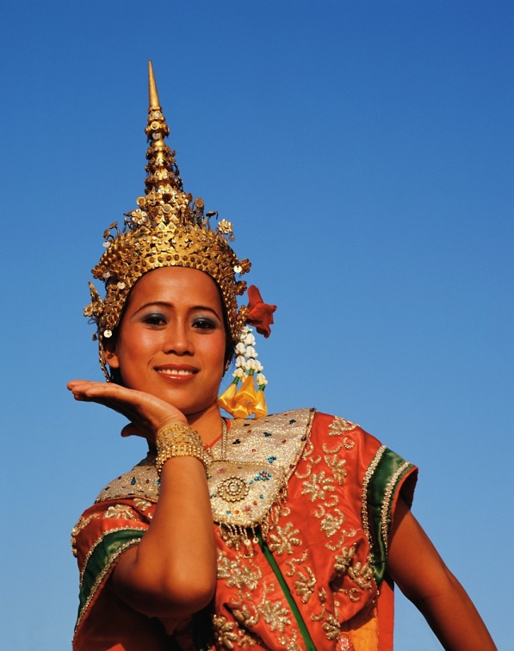

Task 7 - The THAI game
You can’t use the words ‘The’ or ‘And’ nor can you use words beginning with ‘H’ or ‘I’

Slide 15
Describe your home

Slide 16
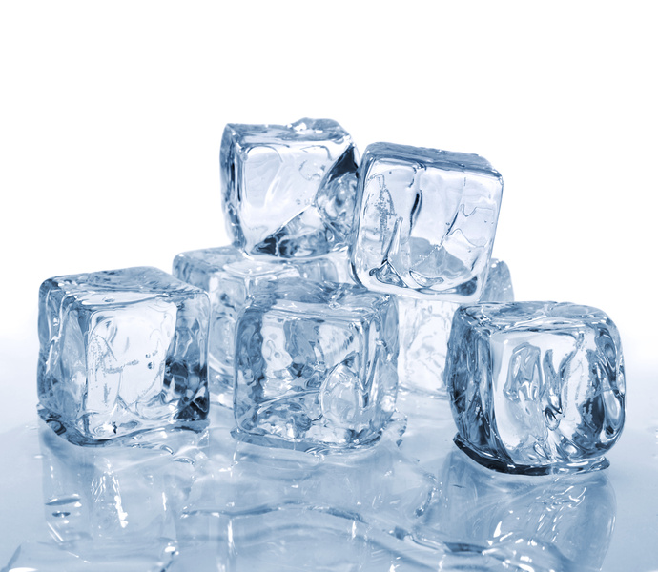
Describe an ice cube

Slide 17
Task 8 -How does Jim feel?

Slide 18
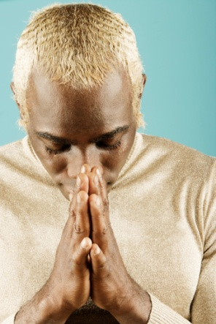


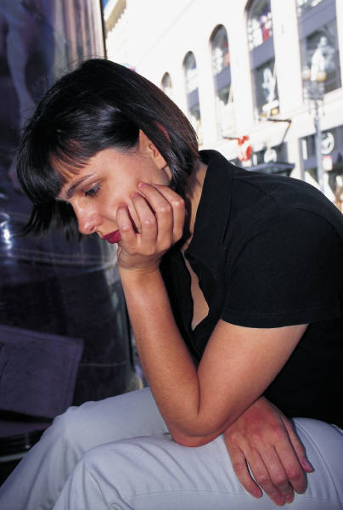

Task 9 - So what have you learnt?

